Slide 1
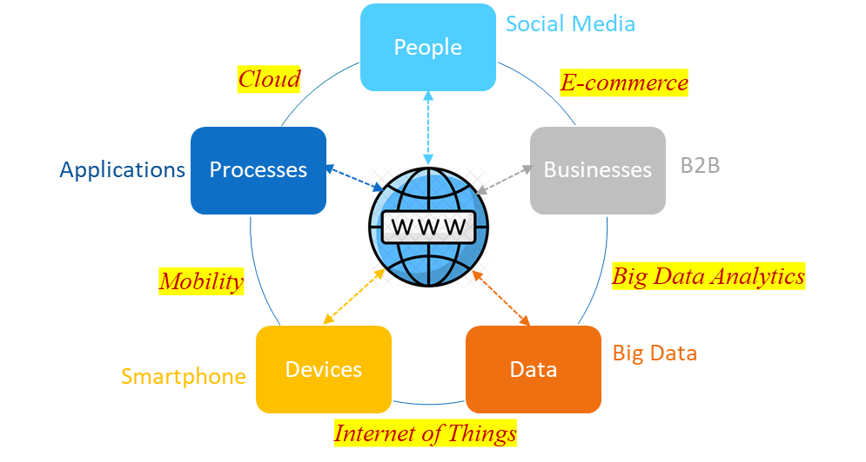
In previous class …

Slide 2
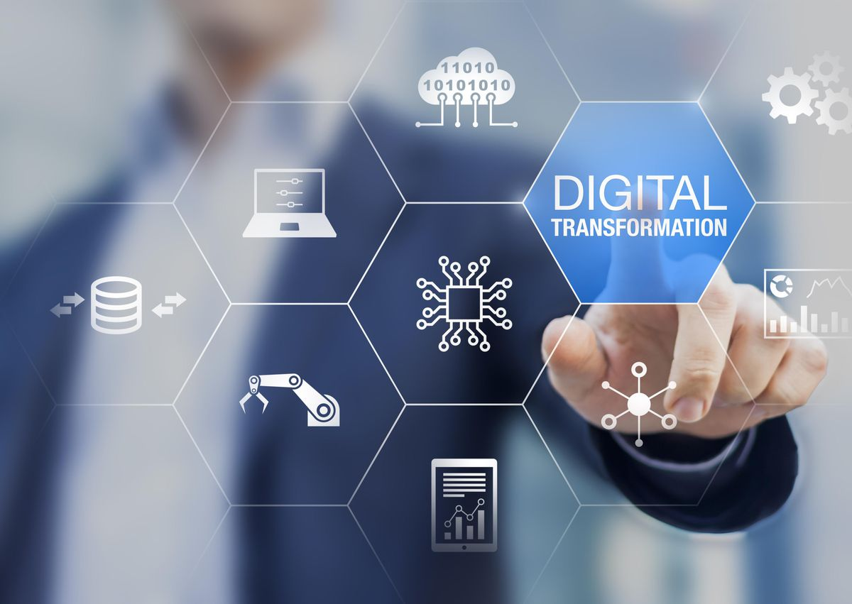
Lecture Series
What is Digital Transformation?
Ashish Pachory

Slide 3
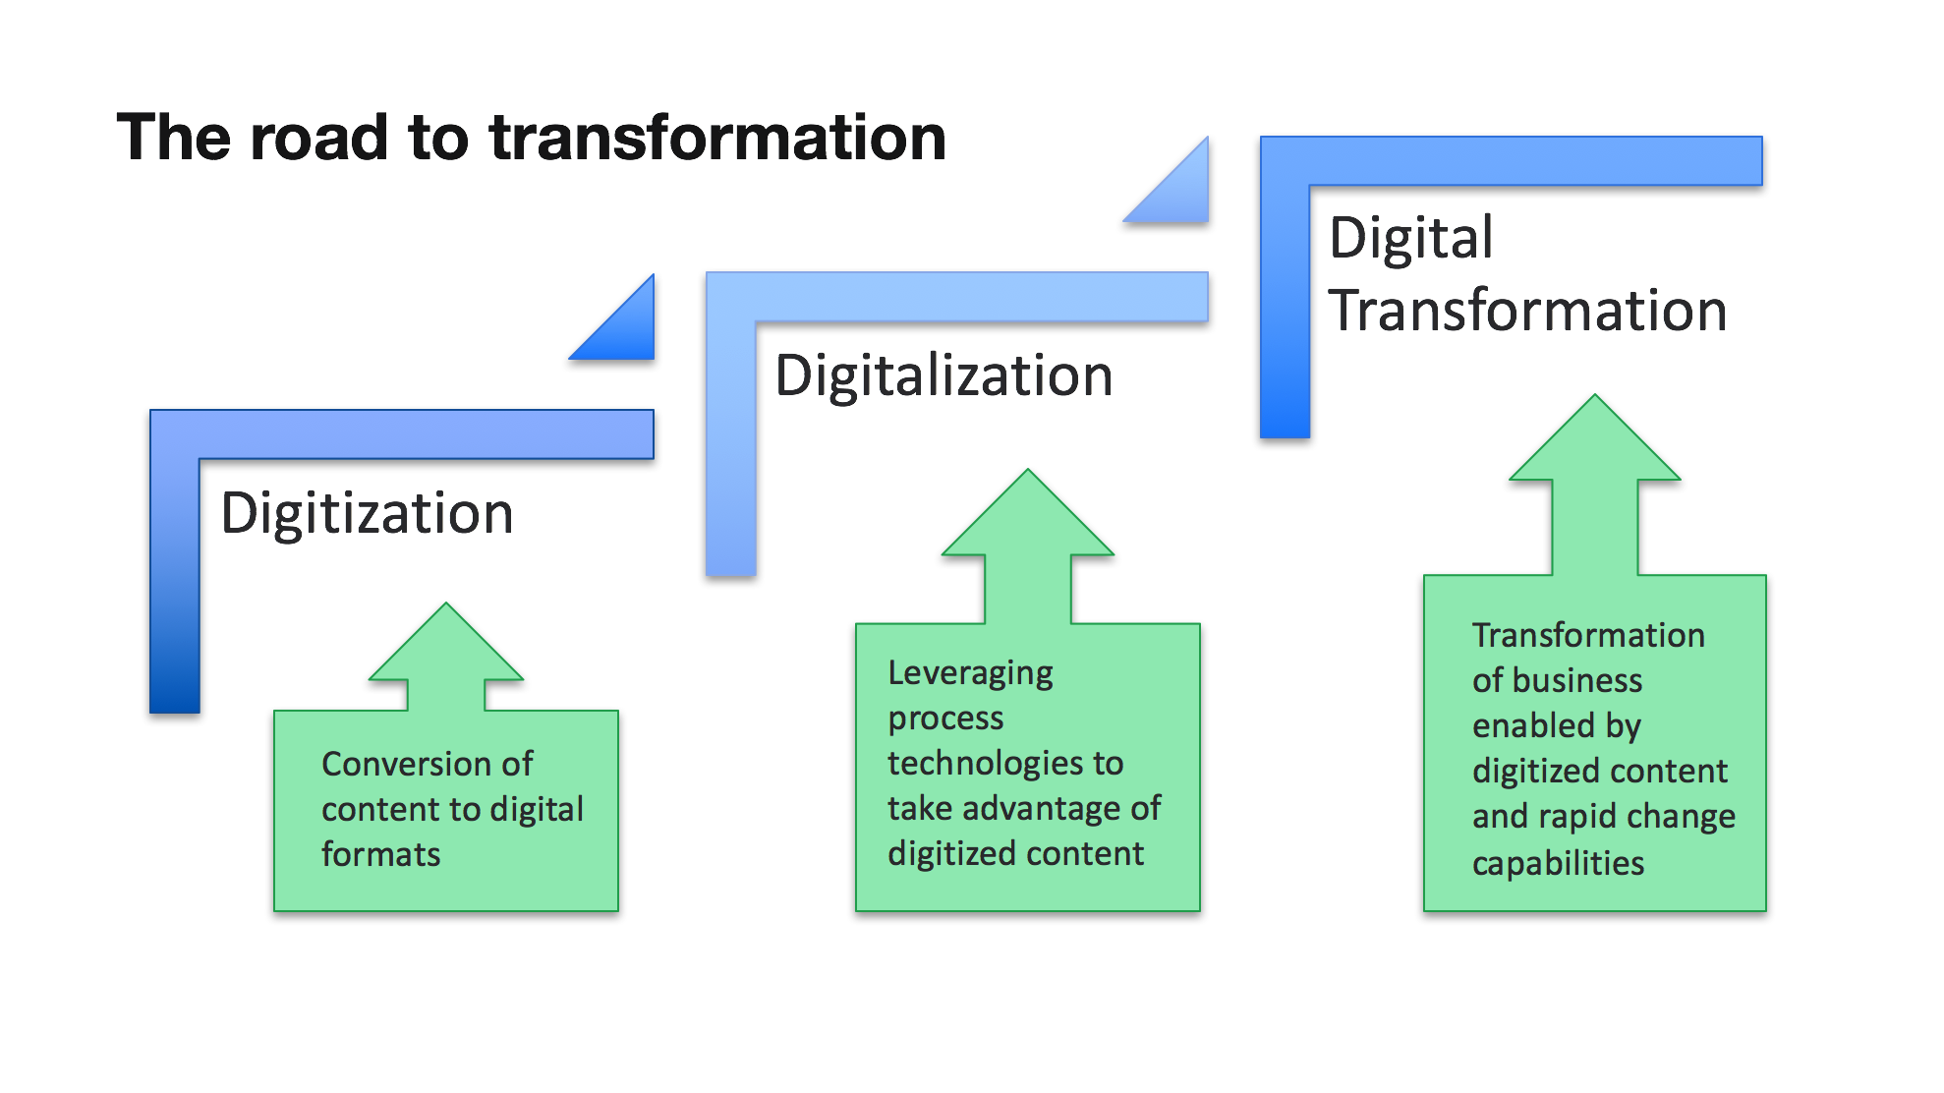
From Digitization to Digital Transformation
Digital Business
Digital Process
Digital Information
Converting information (such as an object, image, sound, document, or signal) into a digital (binary) format that is computer-readable.
The adoption of digital technology to transform services or businesses, through replacing non-digital or manual processes with digital processes. It involves transforming not only technology, but also people (skills/culture) and processes
The use of digital technology (Computers to Cloud) to improve operations (e.g. customer service), with digital information at the core.

Slide 4
Why do companies transform to digital?
Q: What are the top 3 drivers of Digital Transformation in your organization? (Drivers are trends or factors that catalyze change.)
55% Evolving Customer behaviors and preferences
49% Increased competitive pressure
Risk Management
Data Privacy
Accessibility
Cybersecurity
Emerging markets
New Business Models
Digital Marketing & Outreach
Adjacencies
53% Growth opportunities in New Markets
42% New Standards in regulatory & compliance
Business Analytics
Product Differentiation
Speed-to-Market
Churn Management
Online channels
Convenience, transparency
Instant gratification
Personalization

Slide 5
SMAC – The Power behind DX
Social Media platforms give business new avenues through which they can communicate with existing and potential customers
Connected devices are the basis for new business models and services offered to customers
Data is a byproduct of business. By analysing it, companies can make smarter decisions and predict future behaviour
Cloud computing offers businesses a quick and flexible way to respond to changes in their markets and access important data/applications.
Social
SMAC refers to the convergence of four independent technologies that are driving digital business
Mobile
Analytics
Cloud
Notes:
.

Slide 6
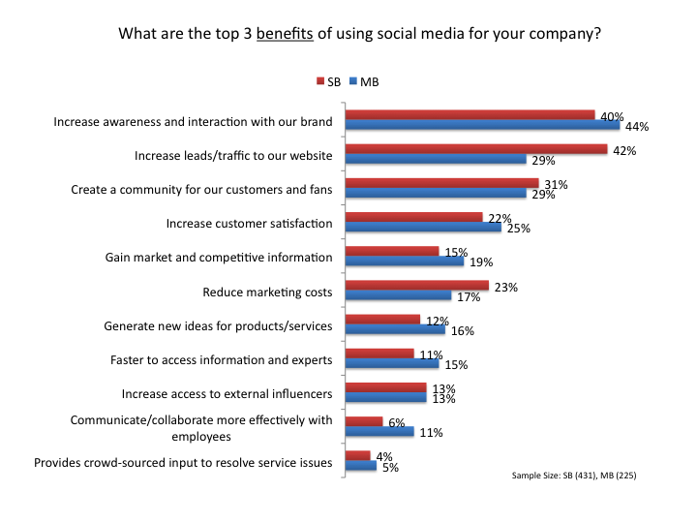
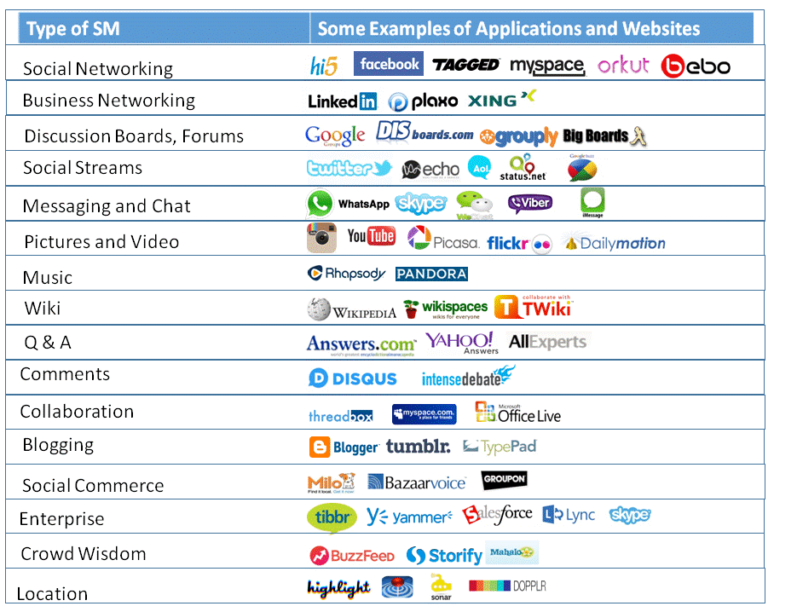
Technology Enablers of DX – Social Media
© Ashish Pachory
Notes:
Key technologies behind SM: L-A-M-P
Open-source operating systems – Linux [L]
Hosting server, or Web Server – Apache [A]
DBMS for oraganizing messages and updates – MySQL [M]
Application software using Python/Perl/PHP – [P]
It also uses IP network for communication and broadcasting of media. Most social media systems offer APIs for developers to build applications on their network

Slide 7
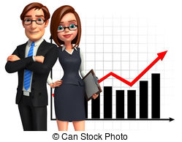
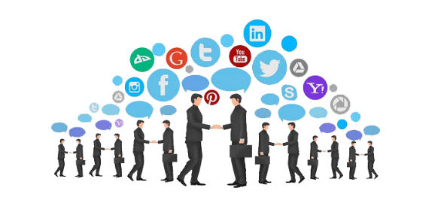

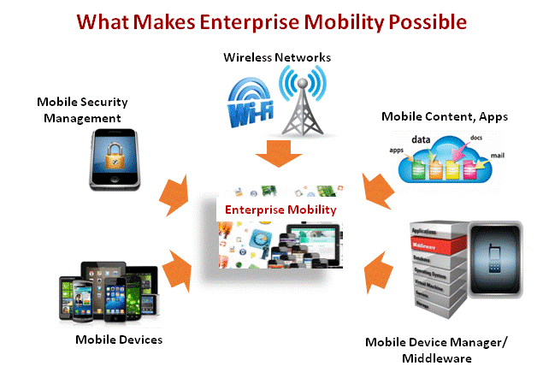
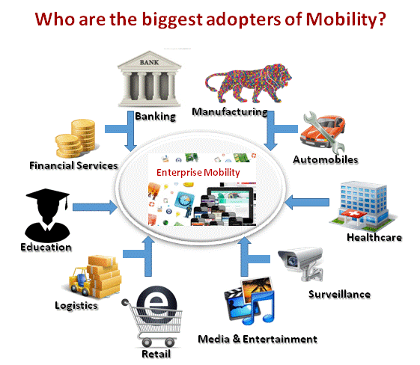
Technology Enablers of DX – Enterprise Mobility
What’s topmost on the minds of enterprise leaders today?
Activating the Business
Transforming to Digital
Empowering People
Making it easy to connect
Higher productivity
Lower expenses
Enhancing the customer experience
Cloud & Mobile enabled freedom
Extending the reach
Be Responsive
Make an impact from anywhere
Happier employees
ENTERPRISE MOBILITY
© Ashish Pachory

Slide 8
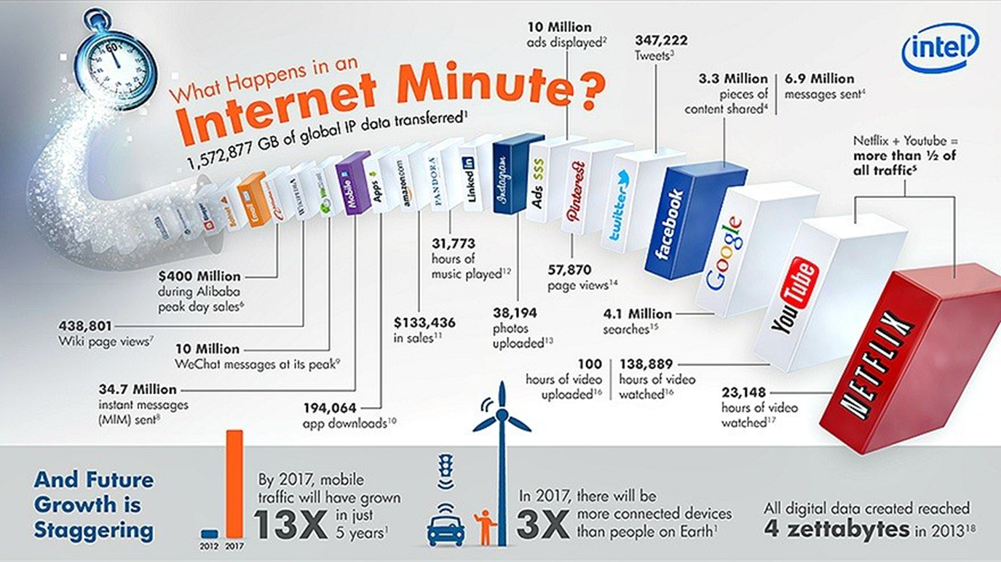
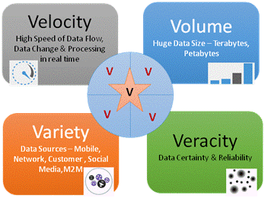
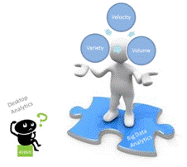
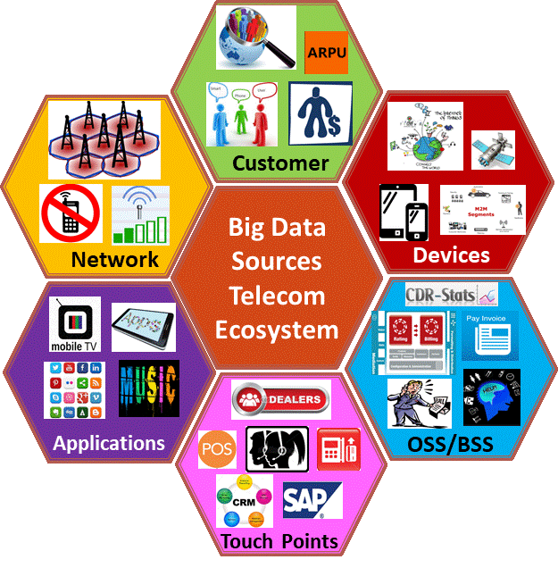
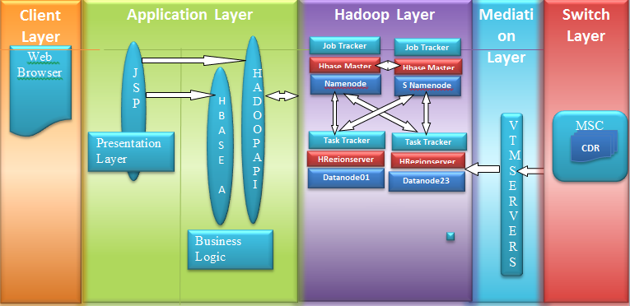
Technology Enablers of DX – Big Data
© Ashish Pachory

Slide 9
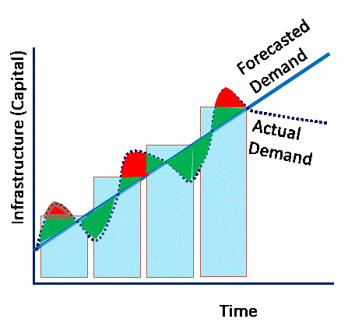
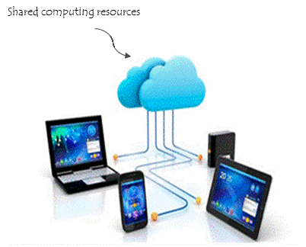
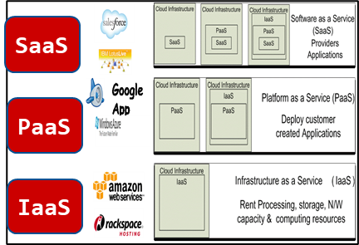
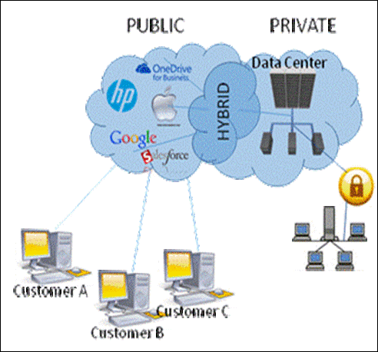
Technology Enablers of DX – Cloud Computing
Device Independ-ence
Shared work-loads
On Demand Solutions For Your Business
Cloud
Surplus & Deficit
Web
Client-Server Computing
Pay-per-Use
On-demand self-service
Personal Computers
Mainframe
Virtual Assembly*
Offsite technology
Why Cloud?
Opex model
SLA-based availability
*Remotely customizing and configuring applications
© Ashish Pachory
Notes:
The main enabling technology for cloud computing is virtualization.
Virtualization is the process of creating a software-based, or virtual, representation of something, such as virtual applications, servers, storage and networks.
Java is the most commonly used programming language for cloud computing
Because the versatility of the Java language allows it to be used in the design of applications for Android, desktop computers, websites, and games
PaaS (Platform as a Service) provides you computing platforms which typically include operating system, programming language execution environment, database, web server etc. Examples: AWS Elastic Beanstalk, Windows Azure, Heroku, Force.com, Google App Engine, Apache Stratos
Software as a service (SaaS) is a software licensing and delivery model in which software is licensed on a subscription basis and is centrally hosted. (Examples: G-Suite, Hub-spot, Drop box, Prime Video, Uber, Slack, Spotify, Whatsapp…)

Slide 10





It All Starts with an Idea …
Digitization Strategy
Application of digital technology
Digital Experiences
An IDEA is the product of INNOVATION, which is the force behind DIGITAL TRANSFORMATION
CEM
Analytics
An IDEA or VISION
Cloud
Happier Customers
Mobile
Social
Competitive Advantage
© Ashish Pachory

